Slide 1

Technology Survey Analysis
Efe Kucak
05.04.2025

Slide 2



OUTLINE
Executive Summary
Introduction
Methodology
Results
Visualization – Charts
Dashboard
Discussion
Findings & Implications
Conclusion
Appendix

Slide 3

EXECUTIVE SUMMARY
JavaScript, SQL, and Python are currently the most widely used languages.
TypeScript and Go show rising demand for next year.
PostgreSQL and Redis dominate database preferences.
41.3% of respondents are aged 25-34.

Slide 4

INTRODUCTION
Purpose: Analyze technology trends to guide future strategies.
Target Audience: Software developers, IT managers, business analysts.
Value: Support data-driven decision-making processes.

Slide 5

METHODOLOGY
Data Sources: Survey data
Collection Methods: Online surveys and APIs.
Data Wrangling: Cleaning missing data, categorical analysis.

Slide 6
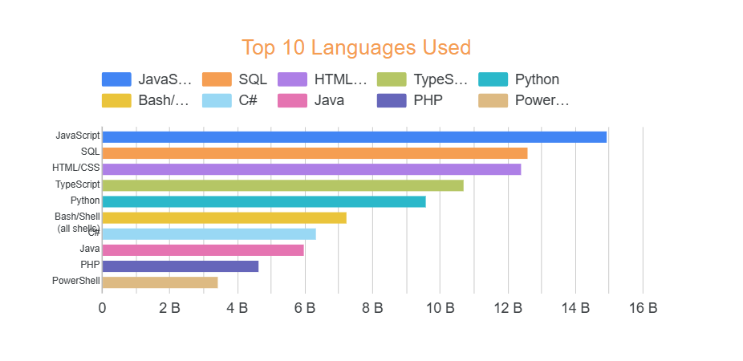
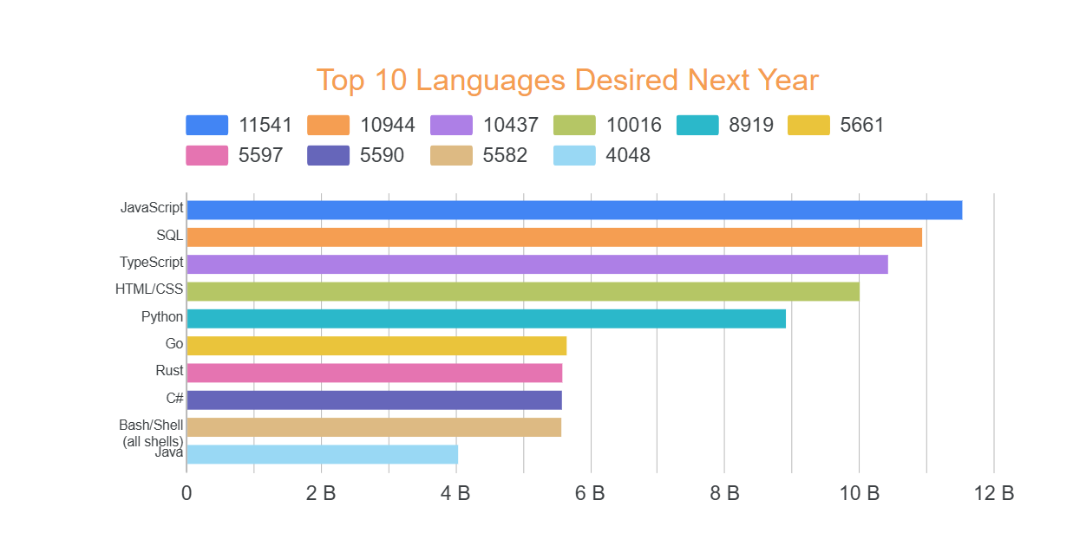
PROGRAMMING LANGUAGE TRENDS
Current Year
Next Year

Slide 7
PROGRAMMING LANGUAGE TRENDS - FINDINGS & IMPLICATIONS
Findings
JavaScript remains #1 but shows declining demand (16B → 11,541).
TypeScript is the fastest-growing language (37% increase to #2 position).
SQL stays consistently strong (#2 → #3), while Python drops slightly (#3 → #5).
Implications
Prioritize TypeScript for web projects needing scalability/maintenance.
Keep Java for enterprise/legacy systems but modernize stacks.
Strengthen SQL skills – still critical for data work.

Slide 8
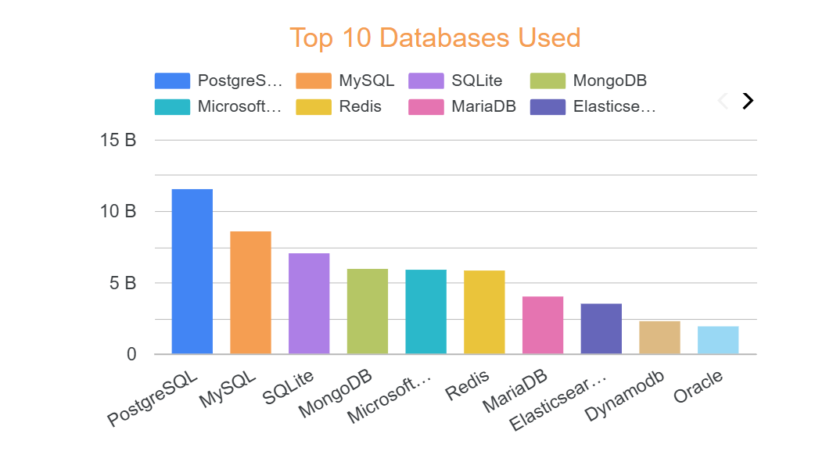
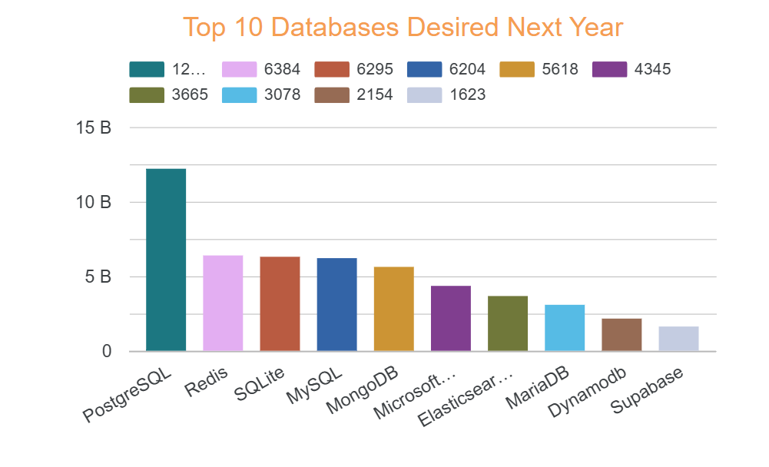
DATABASE TRENDS
Current Year
Next Year

Slide 9
DATABASE TRENDS - FINDINGS & IMPLICATIONS
Findings
PostgreSQL dominates both current usage and future demand (#1 position).
Redis surges in future demand (likely due to real-time app needs).
Legacy databases (e.g., MySQL, SQLite) remain stable but show slower growth.
Implications
Standardize on PostgreSQL for transactional workloads (scalability + features).
Adopt Redis for caching/real-time use cases (sessions, queues).
Modernize legacy DBs (MySQL/SQLite) with extensions or hybrid architectures.

Slide 10

DASHBOARD
Current Technology Usage:
Charts: Languages, databases, cloud platforms.
Future Technology Trends:
Next-year demand visualizations.
Demographics:
Age, education level, and country distributions.

Slide 11
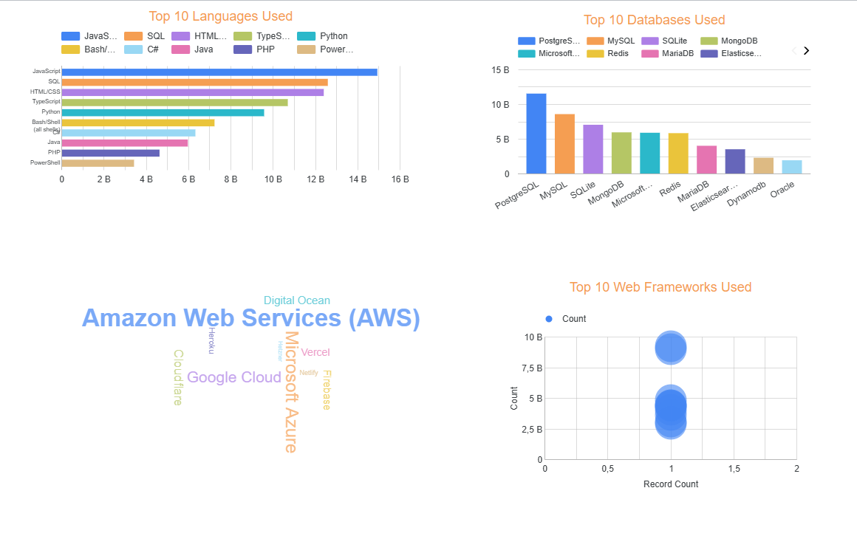
DASHBOARD TAB 1

Slide 12
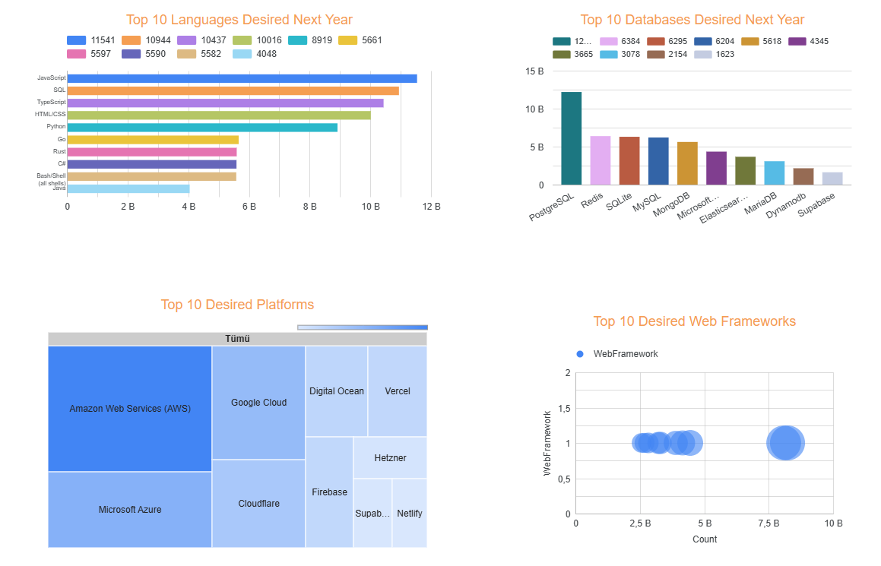
DASHBOARD TAB 2

Slide 13
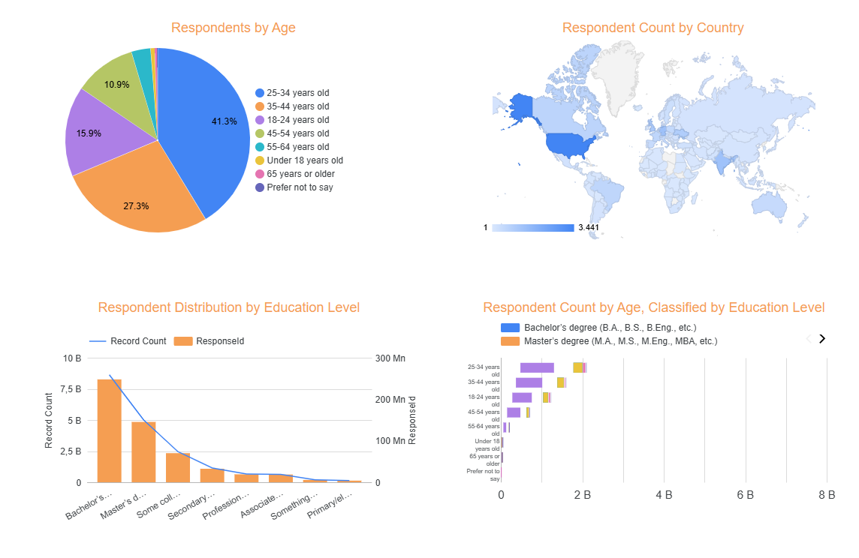
DASHBOARD TAB 3

Slide 14
DISCUSSION

Slide 15
OVERALL FINDINGS & IMPLICATIONS
Findings
Web Technologies Dominate
JavaScript/TypeScript and PostgreSQL lead both current usage and future demand.
Cloud platforms (AWS, Azure, Google Cloud) are critical for deployment.
Real-Time & Scalability Focus
Redis and TypeScript show the fastest growth, highlighting demand for low-latency and maintainable systems.
Go/Rust emerge for high-performance needs (cloud infrastructure, systems programming).
Demographics Shape Trends
25-34 age group (41.3% of respondents) drives adoption, with strong representation from bachelor’s/master’s degree holders.
Developed markets (US, EU) lead in adopting cutting-edge tools.
Implications
Modernize Full-Stack Development
Prioritize TypeScript + PostgreSQL/Redis for new projects.
Train teams in Go/Rust for infrastructure roles.
Optimize for Real-Time & Cloud
Invest in Redis for caching and serverless cloud solutions.
Migrate legacy systems to hybrid SQL/NoSQL architectures.
Align with Workforce Trends
Tailor training for young professionals (25-34) with degrees.
Focus on AWS/Azure certifications to match market demand

Slide 16

CONCLUSION
Web & Cloud-Centric Future
JavaScript/TypeScript and PostgreSQL remain foundational, while Redis and Go/Rust address scalability and performance needs.
AWS/Azure/Google Cloud dominance requires continuous investment in cloud-native solutions.
Shift Toward Real-Time & Maintainability
The rise of TypeScript (frontend) and Redis (backend) reflects industry demand for type-safe, low-latency systems.
Legacy technologies (Java, MySQL) persist but require modernization to stay competitive.
Demographics Drive Adoption
The 25-34 age group (41.3% of respondents) and highly educated professionals are key adopters of emerging tools.
Training and hiring strategies should align with these trends to ensure workforce readiness.

Slide 17
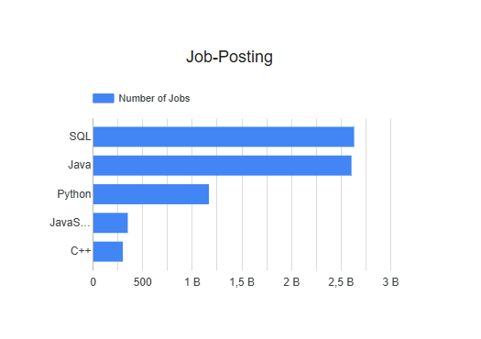
JOB POSTINGS

Slide 18
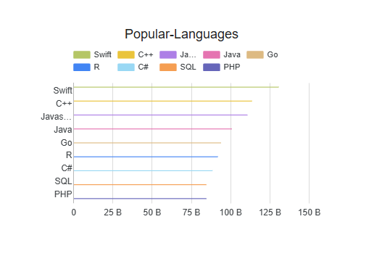
POPULAR LANGUAGES

